Slide 1

avecon Telecom
5G LAUNCH
IMPACT ANALYSIS
Insights into Wavecon’s Performance Post-5G Launch
Internship Project | AtliQ Technologies Pvt. Ltd.

Slide 2
Business Questions
This analysis focuses on answering the following key business questions:
What was the impact of the 5G launch on Wavecon’s revenue?
Which KPI underperformed after the 5G launch?
Which plans performed well and which performed poorly after the 5G launch?
Which plans were most affected by the 5G launch, and should they be continued or discontinued?
Were any plans discontinued after the 5G launch, and what was the reason?
How has Wavecon’s market share changed compared to competitors after the 5G launch?

Slide 3
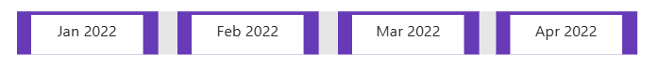


Timeline – Before vs After 5g
Before 5g launch: January 2022 – April 2022
5g launch: May 2022
After 5g launch: June 2022 – September 2022
Before 5g
5g Launch
After 5g

Slide 4
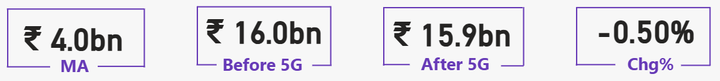
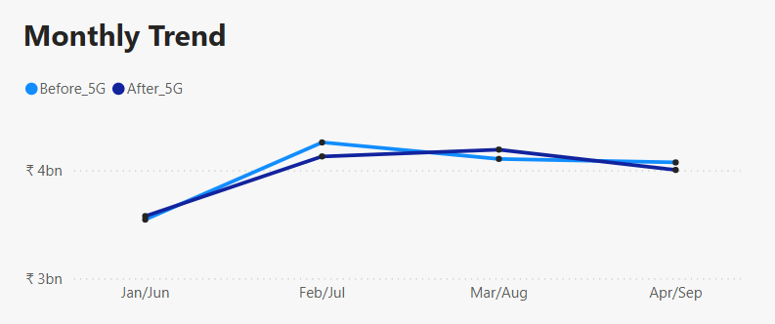
1. Impact of 5G Launch on Revenue
Revenue remained stable after the 5G launch, declining slightly from ₹16.0bn to ₹15.9bn (-0.5%).
Revenue trends before and after the 5G launch show minimal variation, indicating limited short-term financial impact.
Early-stage 5G adoption may be delaying significant revenue growth.

Slide 5
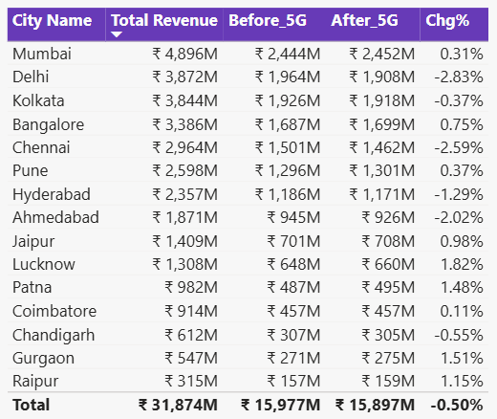
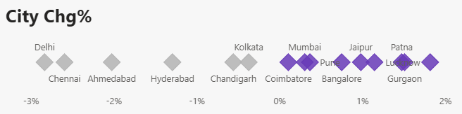
1. Impact of 5G Launch on Revenue
Revenue impact varies across cities, with some markets showing growth while others experienced declines after the 5G launch.

Slide 6
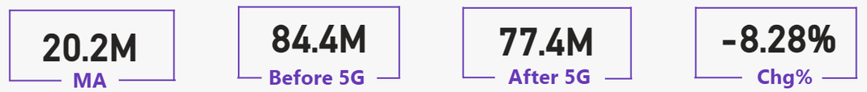
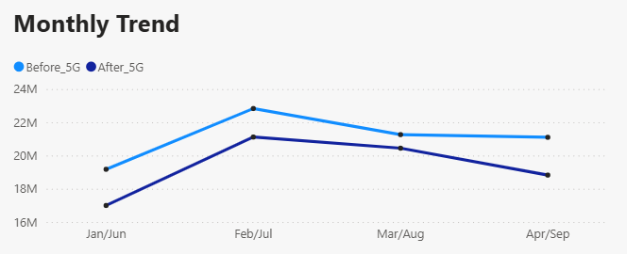
2. Underperforming KPI After 5G Launch
Total Active Users declined from 84.4M to 77.4M, representing an 8.28% decrease after the 5G launch.
Active users show a consistent downward trend after the 5G rollout, suggesting reduced engagement or slower adoption of 5G services.
Despite the 5G rollout, user engagement weakened, indicating the need for stronger customer acquisition and retention strategies.

Slide 7
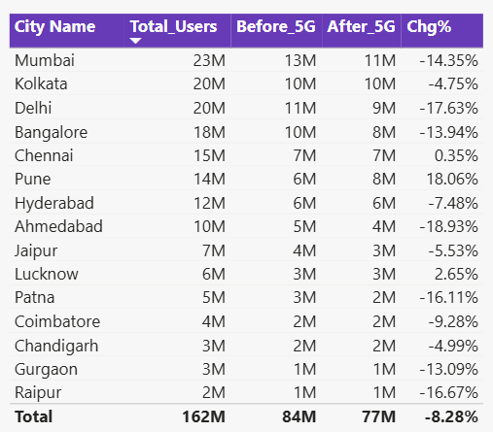
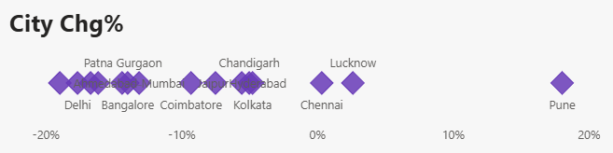
2. Underperforming KPI After 5G Launch
Most cities experienced a decline in active users, with only a few markets showing marginal growth, indicating uneven customer response to the 5G launch.

Slide 8
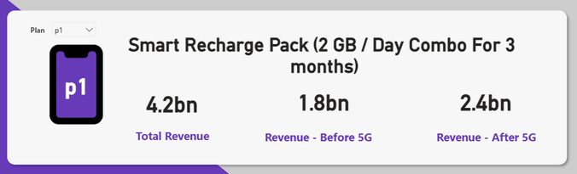
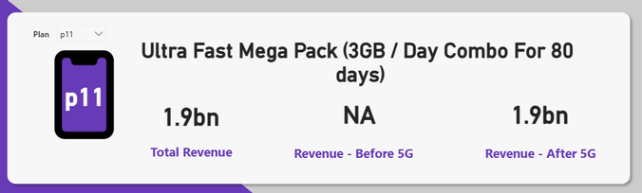
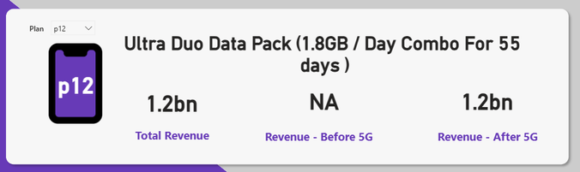
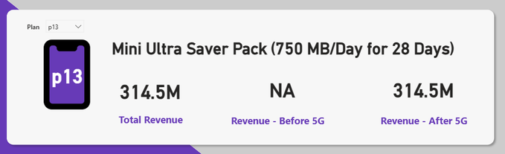
3. Plan Performance After the 5G Launch
Plans Performing Well
High-data plans saw strong revenue growth, driven by higher demand for large data packages post-5G.
Long-validity plans contributed significantly, with customers preferring stable, long-term options.
Premium data bundles gained popularity as 5G encouraged users to adopt higher data usage.

Slide 9
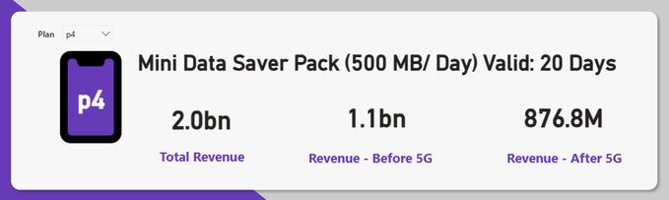
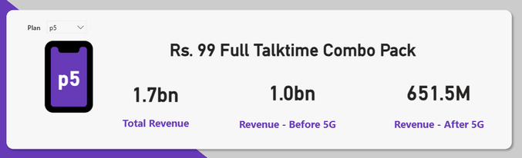
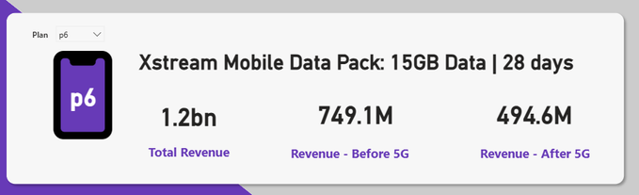
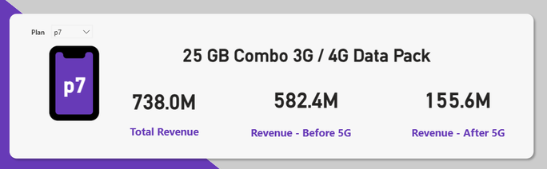
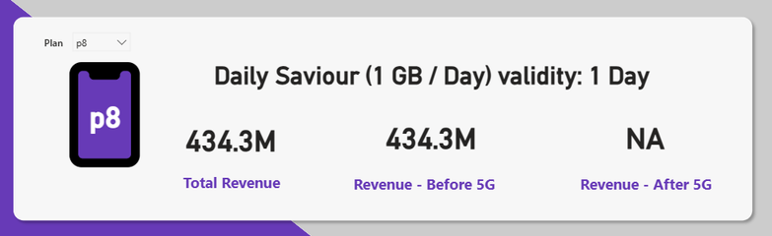
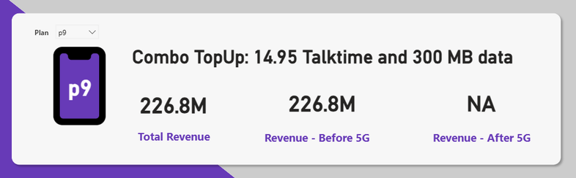
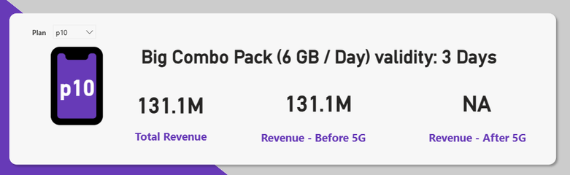
3. Plan Performance After the 5G Launch
Plans Performing Poorly
Low-data saw a decline in revenue, suggesting reduced demand in the 5G era.
Short-term validity plans showed weak performance, with users shifting to longer-term options.
Small utility / top-up plans contributed little revenue, showing reduced relevance with 5G.

Slide 10
4. Most Affected Plans by the 5G Launch
Highly Affected
Plan p7 saw the biggest revenue drop, reflecting lower demand for legacy 3G/4G data packs.
Plan 4 faced a significant decline, indicating reduced interest in low-data packs.
Plan 5 and Plan 6 experienced a revenue dip, as users shifted to higher data and 5G-enabled plans.
Recommendation
Plan 7: Discontinue or upgrade to a higher data pack for 5G.
Plan 4: Enhance with more data benefits to compete in the 5G market.
Plans 5 & 6: Continue with improved data offerings to align with 5G demand.

Slide 11
5. Plans Discontinued After the 5G Launch
Plans p8, p9, p10: These plans generated no revenue after the 5G launch.
Reason
These plans had low demand due to their limited data, short validity, and misalignment with 5G usage trends.
Customers now prefer longer validity and higher data offerings, aligning with 5G capabilities.

Slide 12
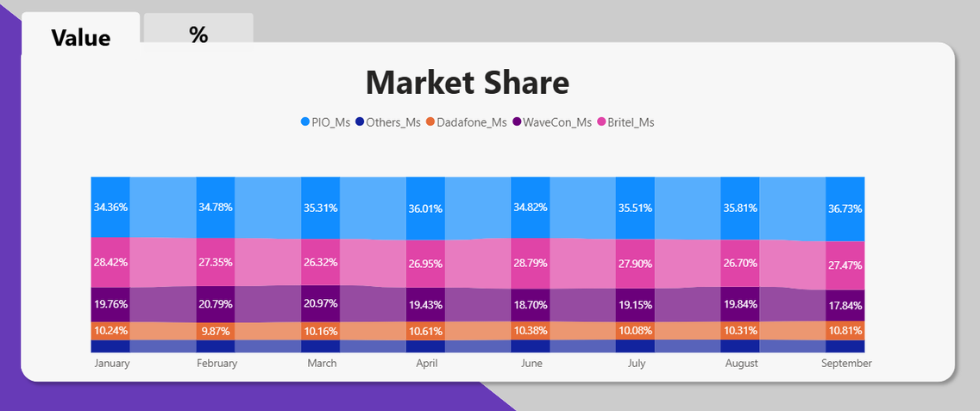
6. Wavecon Market Share vs Competitors
Observations:
Wavecon held a moderate market share (~18-20%), staying behind PIO, the market leader (~35-37%).
PIO showed strong growth in market share post-5G, while Wavecon's share remained largely stable.
Britel and Dadafone showed minimal changes in their market share.
Insights:
Wavecon's 5G launch increased ARPU but failed to prevent customer churn.
Although Wavecon saw stability in market share, it lagged behind PIO, highlighting the need for stronger 5G adoption and enhanced offerings.
Wavecon's focus should shift towards expanding 5G adoption and increasing competitive advantages to capture market share from PIO and others.

Slide 13
Key Takeaways & Strategic Recommendations
Key Takeaways:
Revenue stability: Revenue slightly declined by 0.5%, showing minimal immediate impact from 5G launch.
Market position: Wavecon holds 18-20% market share, trailing behind PIO, the market leader.
Plan performance: High-data and long-validity plans performed well, while low-data and short-term plans underperformed.
Customer churn: A decrease in active users after the 5G launch signals need for improved customer engagement.
Recommendations:
Focus on high-data plans: Continue and upgrade high-data and long-validity plans to capture 5G demand.
Enhance customer engagement: Invest in retention strategies to counteract customer churn.
Revise low-data plans: Discontinue or improve low-data and short-term plans to align with 5G trends.
Differentiate 5G offerings: Strengthen 5G features to compete more effectively against market leaders.

Slide 14
THANK YOU
For your time and attention.
Should you have any questions or require further clarification, please feel free to reach out.
Alisha Mahanty
Data Analyst Intern – AtliQ Technologies

